Slide 1

RecallGuard
CS5610 Project 2
Track products and check safety recalls
Sheng Qin and Tian Yuan, Northeastern University

Slide 2
Users and user stories
Norman
Owns electronics and household products
Add, edit and delete products
Search by brand and category
Check possible recall matches
Sarah
Follows recalls and tracks next steps
Search government recall records
Save notices to a watchlist
Update notes and action status

Slide 3
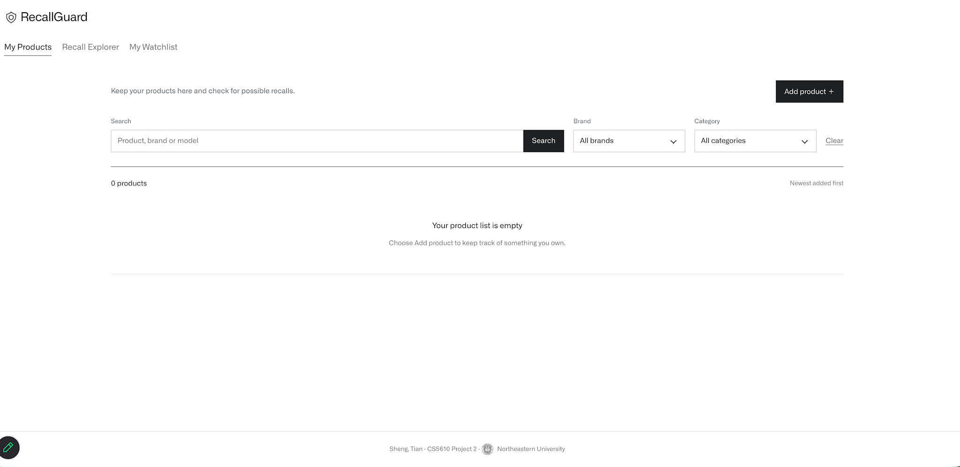
My Products
Sheng Qin
Add, edit and delete products
Search by brand and category
Check possible recall matches
Inventory search and filters

Slide 4
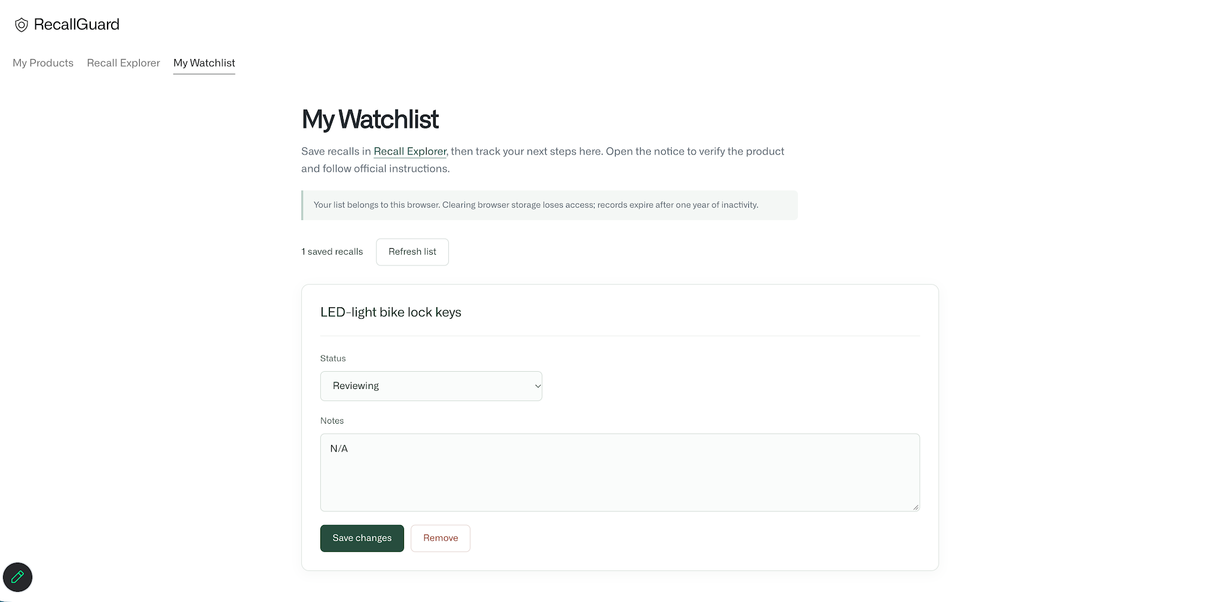
Recall Explorer and Watchlist
Tian Yuan
Search and filter official recalls
Save notices for later
Update notes and status, or remove saved recalls
Saved recall with status and notes

Slide 5
Application and data
Vanilla ES6 and Fetch on the client
Node.js and Express with the MongoDB native driver
Collection | Data and operations | Owner
products | Owned products, full CRUD | Sheng Qin
watchlist | Saved recalls, full CRUD | Tian Yuan
recalls | Shared government records, read only | Shared
users | Browser identity and expiry | Shared
15,262 shared recall records from CPSC and Health Canada

Slide 6
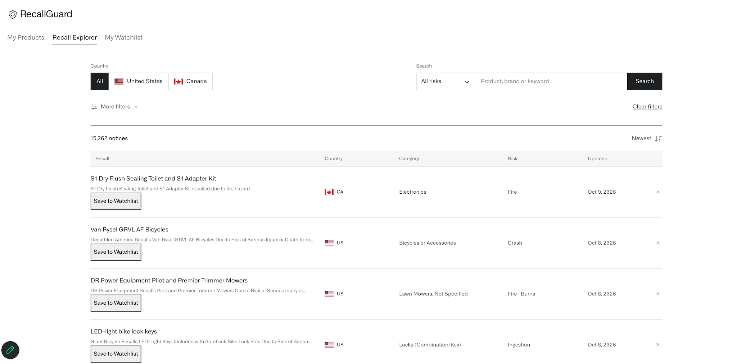
Website demonstration
Products and recall matches
Recall search and Watchlist

